Slide 1

Replacing a cloud based computation tool on DrBoxOnline.com with faster running neural network

Slide 2
Section Instructor
Group members
Jigang Wu
Keye Chen
Yanzhuo Cao
Shuo Deng
Fengyu Zhang
Yukuan Zhu
Sponsor
Shane Johnson

Slide 3
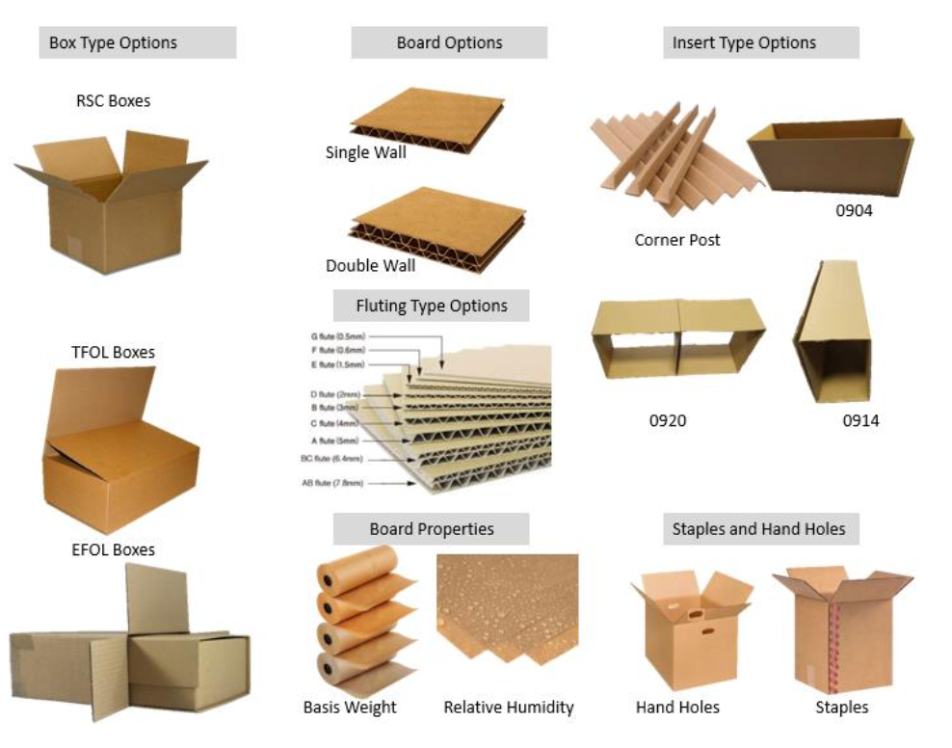
Problem Definition
Corrugated boxes often buckle during storage and shipment, leading to damage and losses
Reliance on Finite Element Analysis (FEA) to predict the nodal and xyz deformation, which is time-consuming and resource intensive.
Notes:
First, let's look at the problem. Nowadays, corrugated boxes often buckle during storage and shipment, leading to product damage, lost revenue, and increased customer complaints. However, traditional Finite Element Analysis (FEA) to predict each nodal buckling strength is extremely time-consuming and resource-intensive, which poses a significant obstacle for quick decision-making and efficient operations.

Slide 4
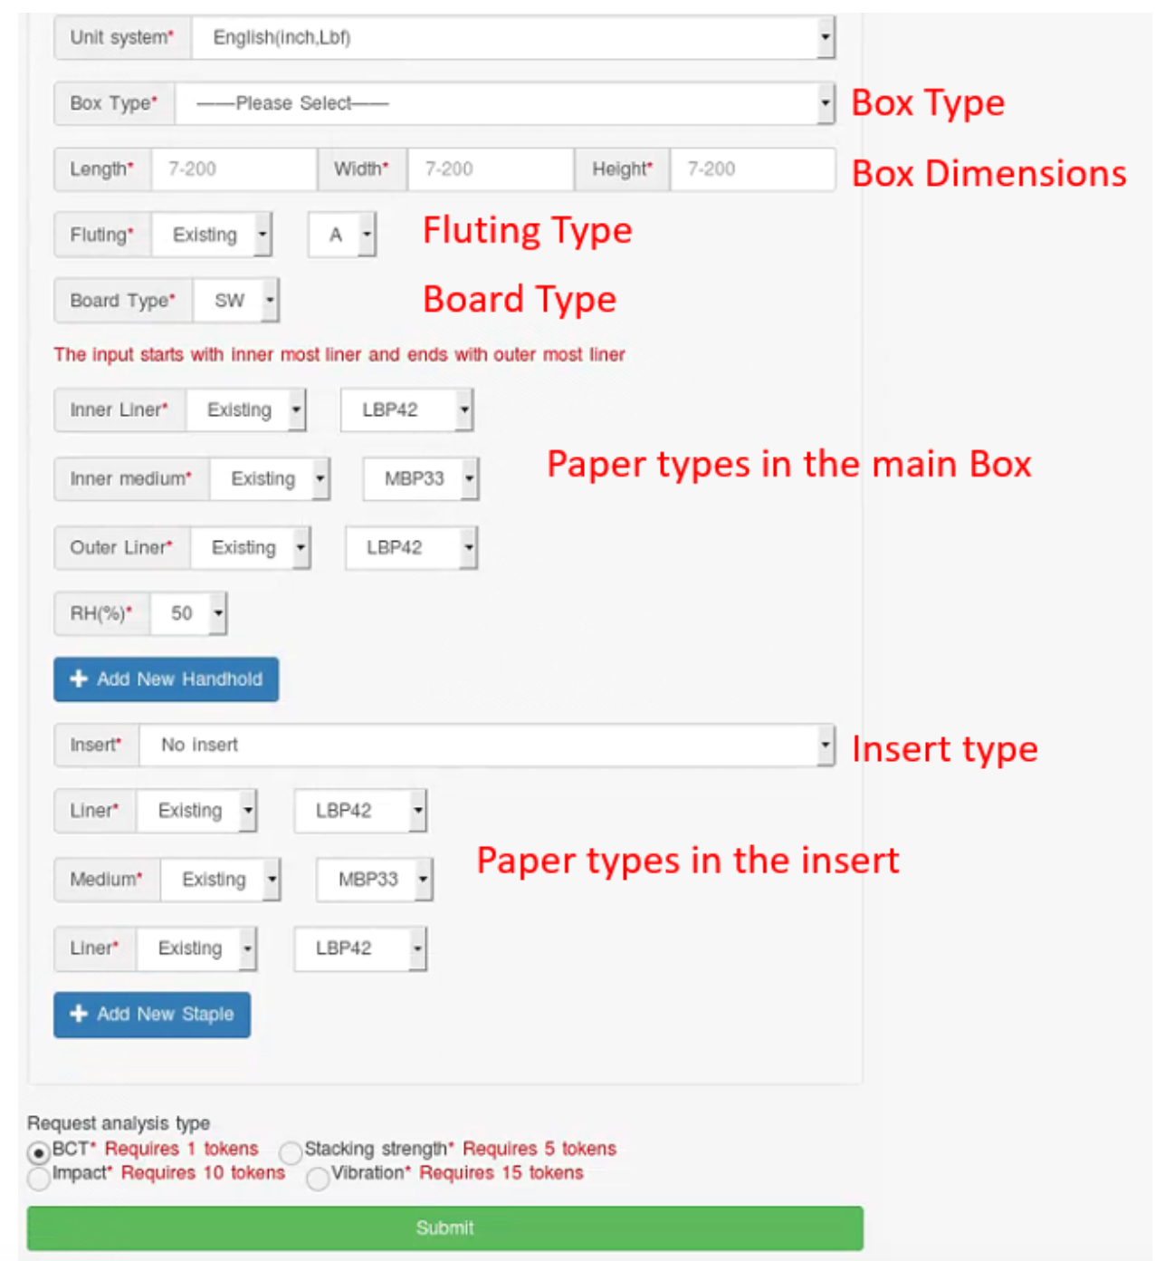
Needs and Solutions
Time: reduce the time to compute each piece of data from seconds to milliseconds
Accuracy: High predictive accuracy (≥ 90%)
scalability: Ability to handle diverse box type and size
Goal: Use deep neural networks to replace physical calculation solution
Input of 3 : box size and type
Output of 769: nodal deformation
Notes:
To address these problems, our project needs to meet several key requirements.
First, we want to reduce the time to compute each piece of data from seconds to milliseconds.
Second, we also want keep the accuracy for each prediction around 90%.
Third, the solution should be able to handle diverse box type and size
Thus, we propose to use deep neural networks to replace physical calculation solution, with 3 input versus 7 hundreds output.

Slide 5
Input Data
Result
Concept Diagrams
User Interaction Interface
Train Data
Max Force
Nodal Failure
Trained Model
Hidden Layers
Hidden Layers
Optimization
Optimization
Minimize MSE Loss
Minimize MSE&cos Loss

Slide 6
Engineering design/methodology analysis
01
Structure should be adapted to inputs and outputs
Structure should reflect real-world mechanisms
Structure
02
Adding complexity to better fit the relationship
Reducing complexity to prevent overfitting and to boost inference speed
Complexity
03
Generally, more good-quality data leads to better model performance
When data source is limited, data augmentation can be performed
Data
Notes:
We designed and experimented with our model following these methodogies
For structure, our model’s structure is adapted to inputs and outputs. Also, the structure should reflect real-world mechanisms.
For model complexity trade-off, adding complexity can better fit the relationship, and reducing complexity can prevent overfitting and boost inference speed. We adjusted the parameters according to the training loss and evaluation loss curves.
When it come to training data, we split 20% of the dataset for cross-validation. Generally, more good-quality data leads to better model performance. When data source is limited, we also performed data augmentation.
Here is how we developed the nodal failure models.

Slide 7
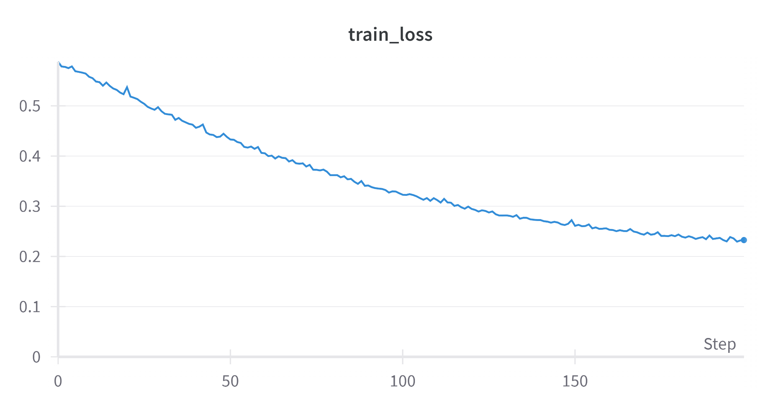
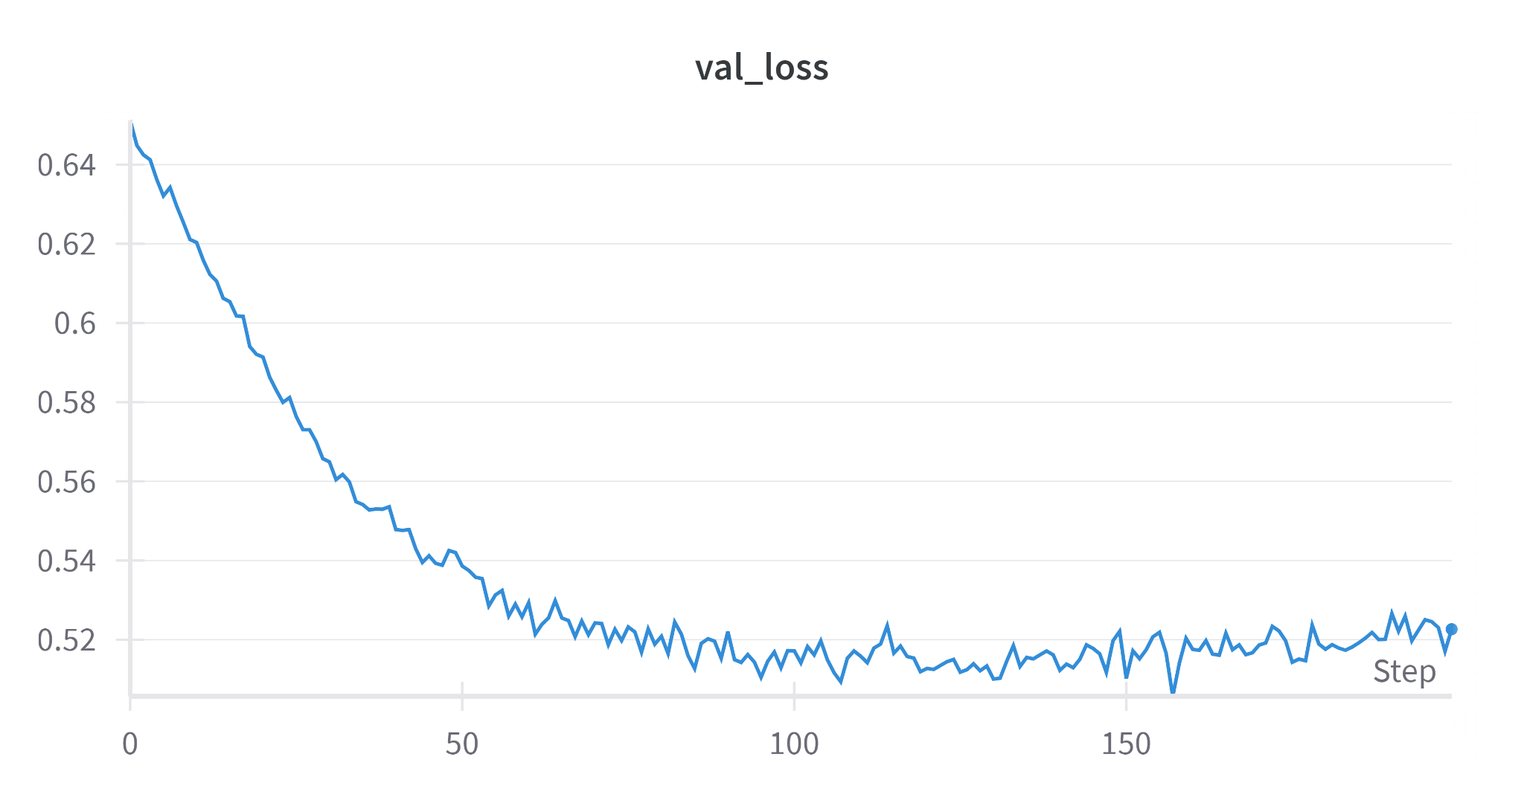
Engineering design/methodology analysis (Model 1)
Primary Multilayer ANN
Adding batch normalization and dropout to prevent overfitting
Parameter num: 268,032
Accuracy: 0.4774
Linear layer
Relu
Batch Normalization
Dropout
3
…
Linear layer
Relu
Batch Normalization
Dropout
Notes:
We first tried the most basic linear model, with batch normalization and dropout layers preventing overfitting. It only has a parameter of about 270 thousand. The parameters struggled to represent the relationship between the variables.

Slide 8
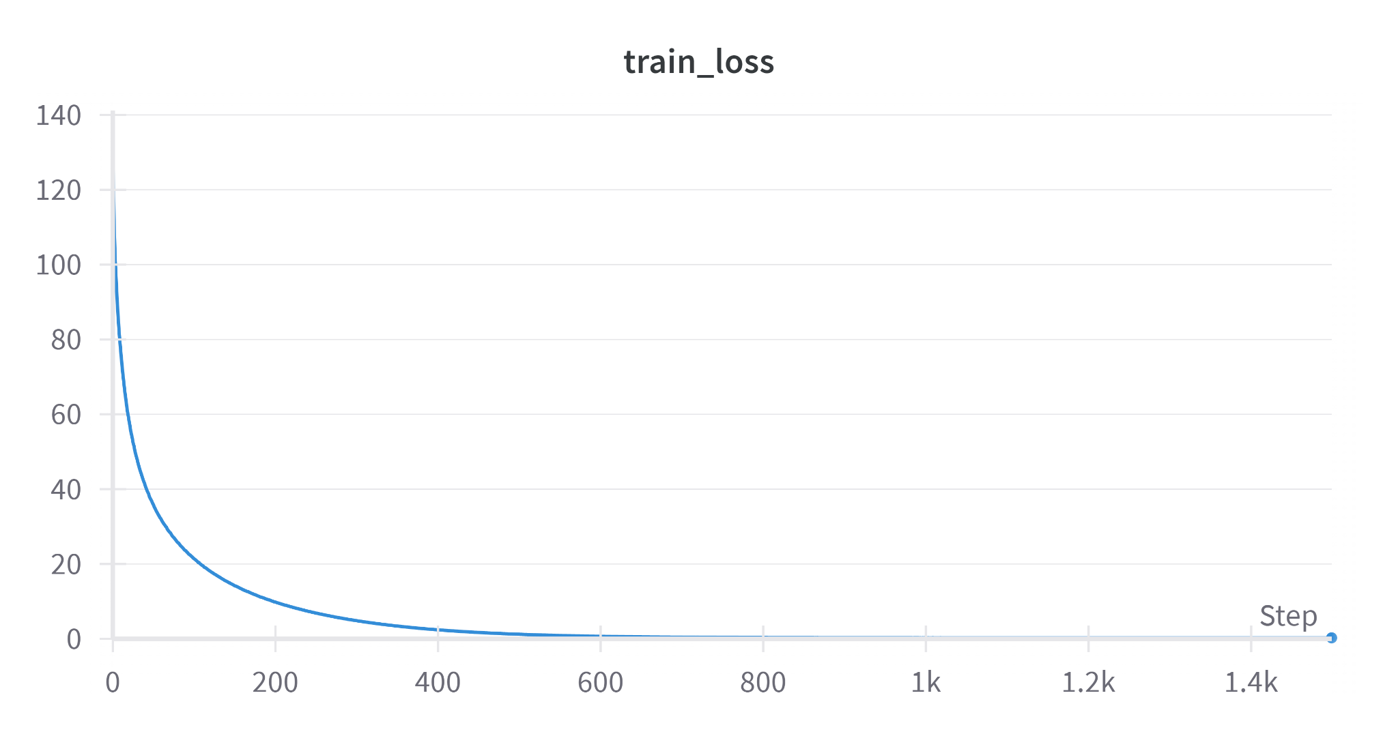
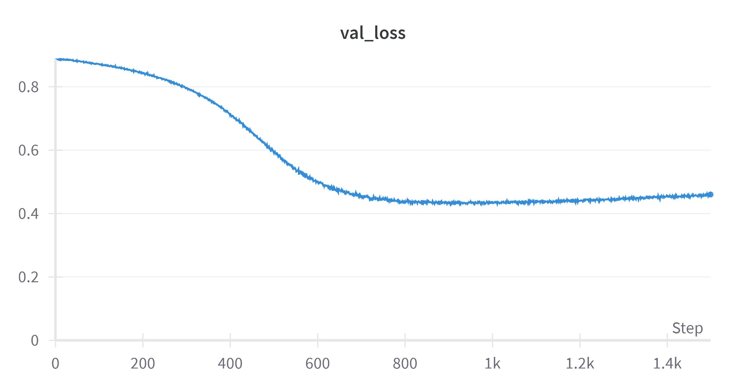
Engineering design/methodology analysis (Model 2)
128 independent models predicting each node to capture nodal independency
Parameter num: 22,219,618
Accuracy: 0.5406
128
Linear
Linear
Linear
Relu
Relu
…
Relu
BN
BN
BN
Dropout
Dropout
Dropout
…
3
Linear
Linear
Linear
Relu
Relu
…
Relu
BN
BN
BN
Dropout
Dropout
Dropout
Notes:
The performance suggests that we need some independent neurons to capture the independency between the 128 nodes. For our second model, we use 128 independent models to predict the failure of each nodes.

Slide 9
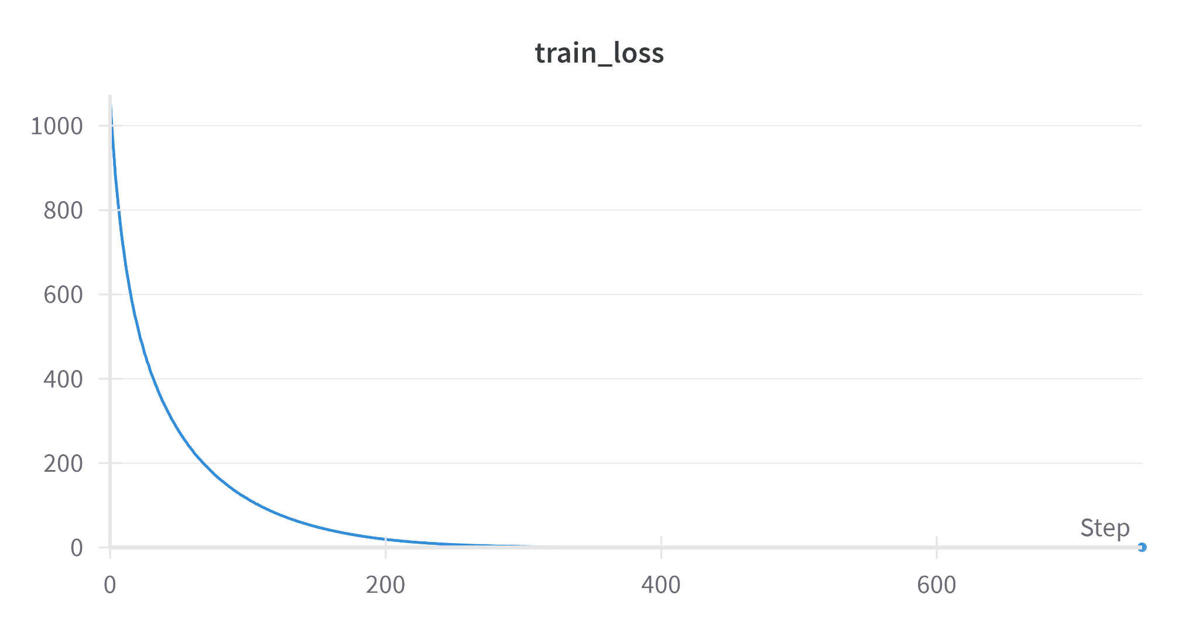
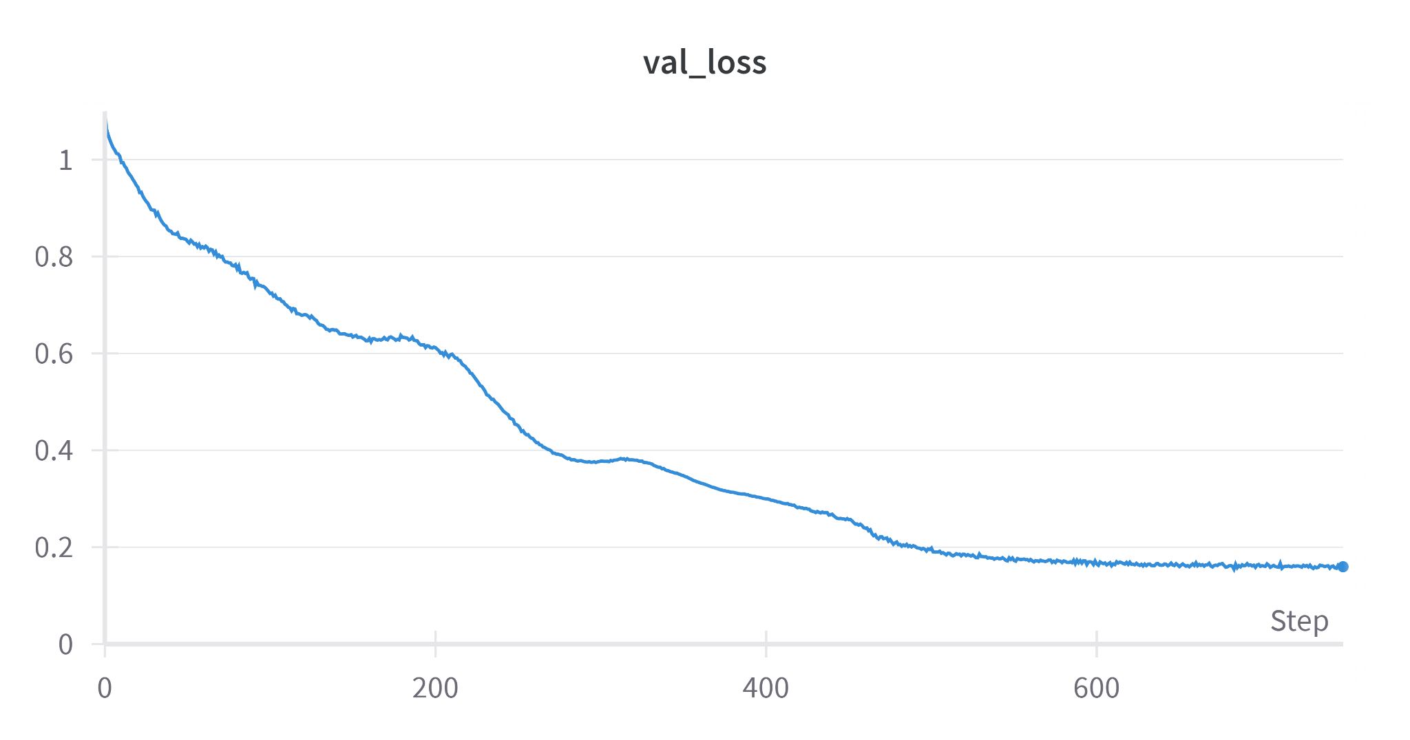
Engineering design/methodology analysis (Model 3)
Single independent layer to capture independency while reducing parameters
Self attention between nodals to simulate dependency
Parameter num: 821,904
Accuracy: 0.8404
128
…
Linear
Linear
Linear
Activation
Linear
Activation
Dropout
Self-attention
Self-attention
Linear
Notes:
To capture independence while reducing complexity, we use a single independence linear layer, followed by self-attention modules simulating the dependency between the 128 nodes. We reduce the parameter num to around 800 thousand, and improve the accuracy to 0.84

Slide 10
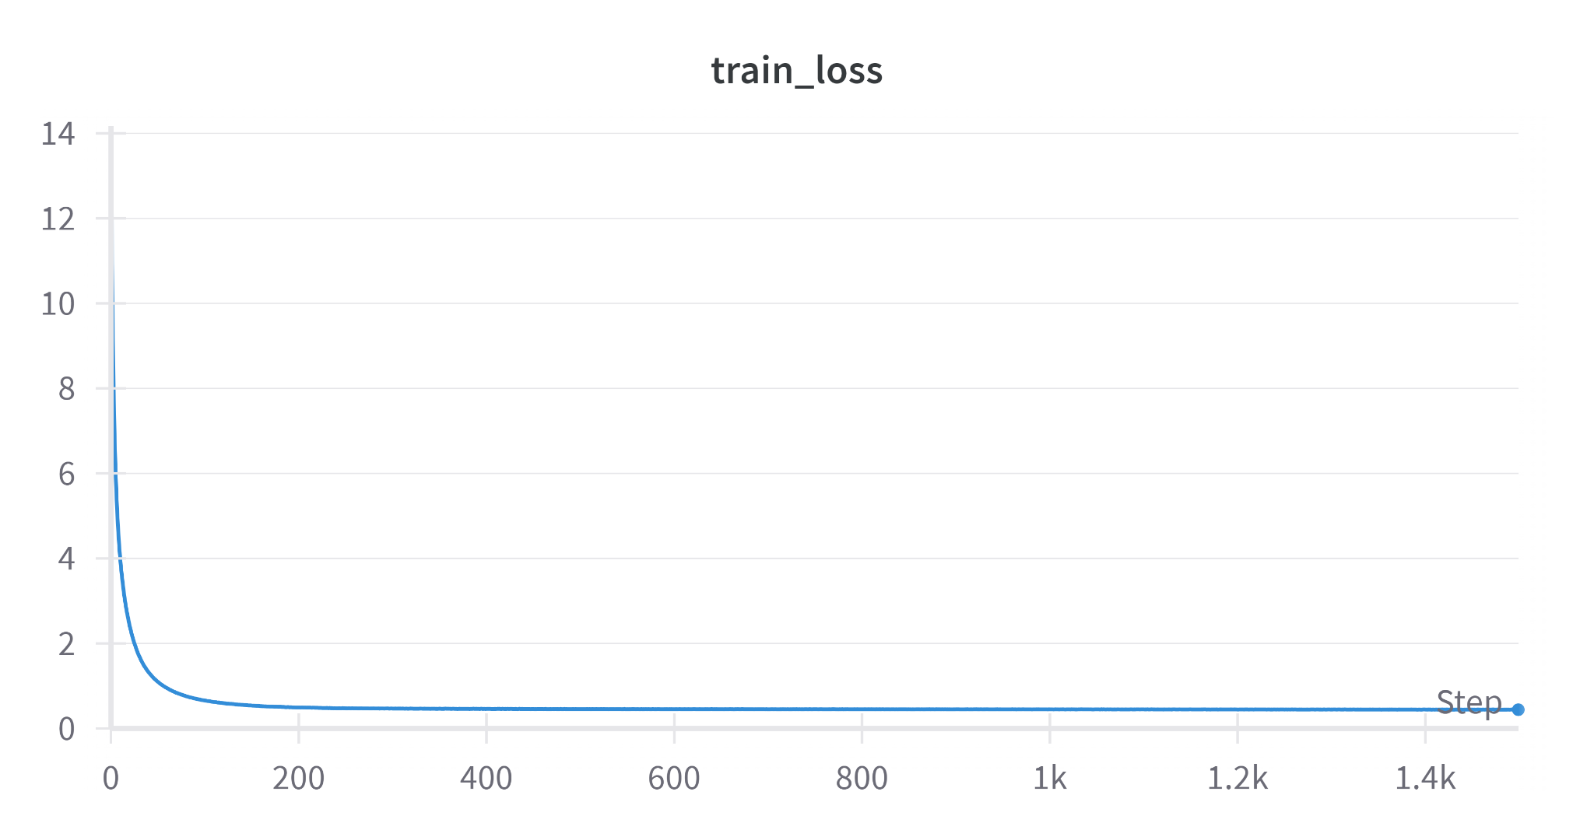
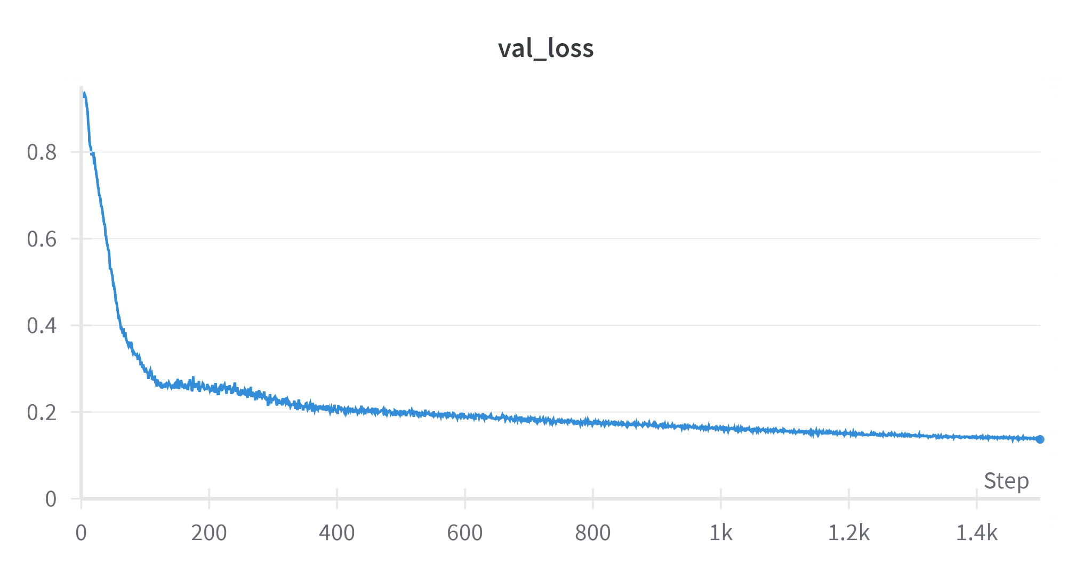
Engineering design/methodology analysis (Model 4)
Single independent layer to capture independency while reducing parameters
Common layers to capture dependency
Parameter num: 431,513
Accuracy: 0.8632
128
…
Linear
Linear
Linear
Activation
Dropout
Linear
3
…
Activation
Dropout
Linear
Notes:
We then further reduce the complexity by using common layers to capture dependency. The parameter num is reduced to 430 thousand and the accuracy is increased to 0.863

Slide 11
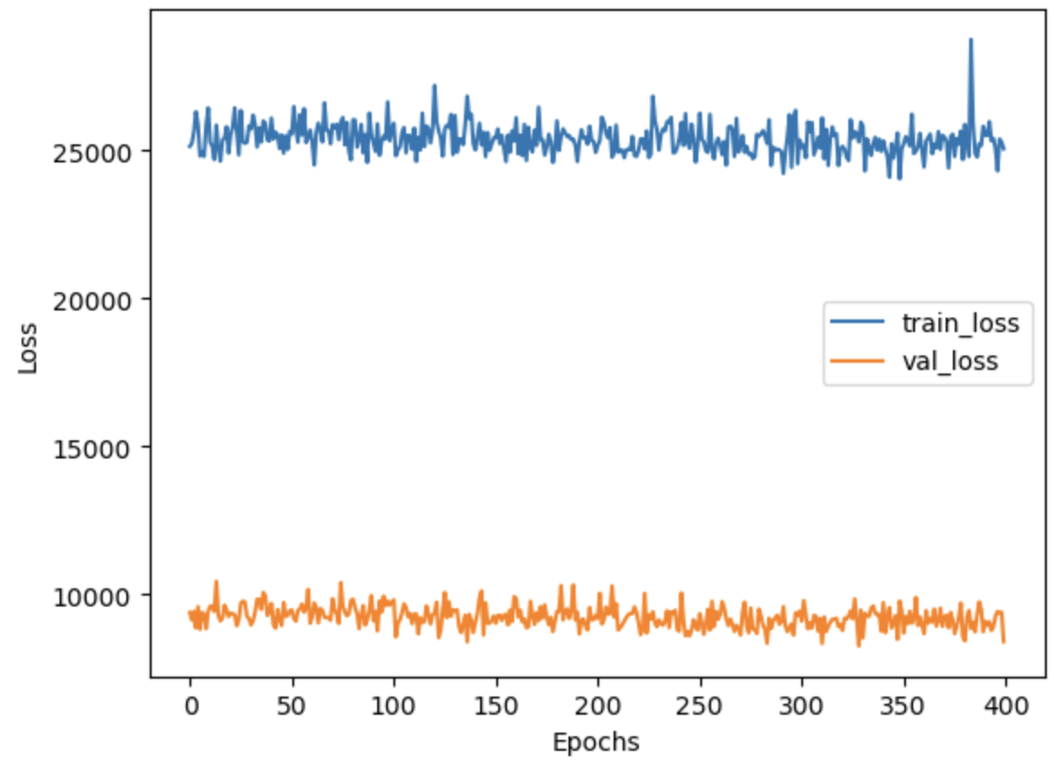
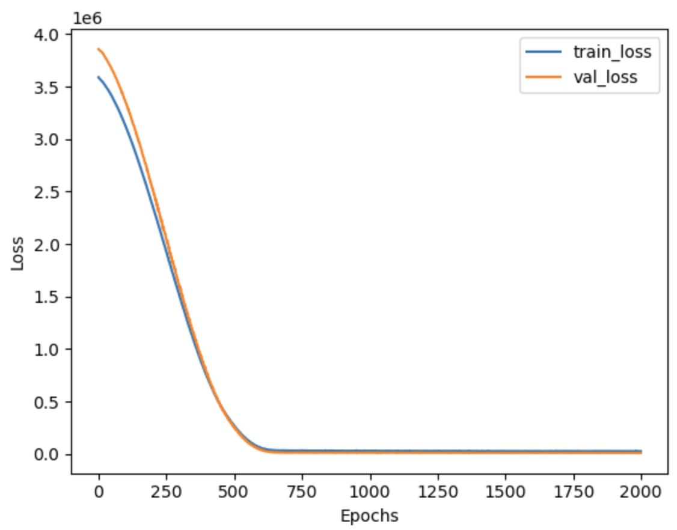
Final design/methodology description
Max Force Prediction:
Data Preprocessing
Augmentation
Model Definition and Training
linear, ReLU, BatchNorm1d, and Dropout layers
Adam optimizer
MSE loss
Model Evaluation
Final Results
Last 400 Epochs v.s. Loss
Notes:
For final model to predict 'Max Force' based on three features (lx, ly, lz) from a dataset.
The data undergoes augmentation by swapping two features to enhance learning.
The model is a neural network with layers designed to handle regression tasks. These layers include linear, ReLU (activation function), BatchNorm1d, and Dropout layers to prevent overfitting and improve generalization.
Also, the model uses an Adam optimizer with a learning rate scheduler to adjust the learning rate during training.
The training process includes both forward and backward propagation, with loss computation using mean squared error (MSE) as the loss function
As we can see the plot on the buttom is the train loss and validation loss, which become smaller as epoch increases. From the visulization of last 400 epochs vs loss we can see the train loss converges around 25000 while validation loss converges sound 10000.

Slide 12
Final design/methodology description
Nodal Failure Prediction:
Data Preprocessing
Augmentation
Model Definition and Training
Linear, ReLU, BatchNorm1d, and Dropout layers
`MultiBranchLinear` handle multiple branches of the network
AdamW optimizer with a very small learning rate
Two Loss Function: MSE Loss and Cosine Similarity Loss
Model Evaluation
Final Results
Notes:
For the nodal failure prediction, we do the same data preprocessing. However, we utilized a MultiBranchLinear to handle multiple branches of the network and also used cosine similarity loss since the each output has multiple diemnations.
The detailed plot is already shown in model 4 introduced by Shuo Deng before.
Now lets see the demo.

Slide 13
Demonstration video of our model
Max Force
https://sjtu.feishu.cn/file/Hk2Kbkf62o8i7mxPbPicEsPEnvc?from=from_copylink
Notes:
Its the demo about the max force prediction. We just randomly sampled from the data and see the difference between the predicted value and the real one.
After two trail, we see that the average accuracy is above 95%, which is far satifying out initial goal of 90%.

Slide 14
Demonstration video of our model
Nodal Failure
https://sjtu.feishu.cn/file/Y8KnbV7ygoVrIfx18nKcYDt0n0f?from=from_copylink
Notes:
Its the demo about the nodal failure prediction. We just do the same thing as above.
After two trail, we see that the average cosine similarity is above 0.75.

Slide 15
Manufacturing or implement
Evaluation of our numerical results:
Evaluation of our costs:
Precision Analysis | Max force that box can afford | Detail analysis on each node
Precision | 93.3% | 82%
Mean Square Error | 10510
MSE After Normalization | 0.0059
Cost Analysis | Our method | Original FEA method
Time | 10ms | 30s
Computational Resources | 1 core | 600 cores
Notes:
Here is our current results. Basically speaking, we have met our goals that have been set in Design Review 1.
As for the precision of the Max force that box can afford, the result we got has already reached xx%. Since this is a variable where most of the data ranges from thousands to tens of thousands, the direct Mean Square Error we got seems to be a little large. However, after we do the normalization to the original data, we can see that the MSE has reduced a lot.
Other outputs are very high dimensions variables showing the detailed shape change in sample nodes. Therefore, we decided to measure the precision based on the cosine similarities, and the result is xx%. Also, we can see that the MSE after normalization is very acceptable.
As for the costs comparing to the original method, it is very obvious that the time and computational resources cost have both been reduced a lot. And we believe that this will surely improve the satisfaction of customers.

Slide 16
Future Work
Build an artificial neural network with more than 20 input parameters to generate the results more precisely.
Obtain more rows of data through a modest amount of data augmentation.
Make a more friendly user interface comparing to the original website to improve the satisfaction of customers.
Notes:
Here is the future work that we decided to finish in the last 3 weeks.
First of all, we only have 3 input parameters for now, and in the future we will try to build an artificial neural network with more than 20 input parameters to generate the results more precisely.
Secondly, we plan to obtain more rows of data through a modest amount of data augmentation, thus making our model predictions more accurate
Finally, we have decided to make a more friendly user interface comparing to the original website to improve the satisfaction of customers. After we complete the ANN, we will deliver the whole product to the customer and see their feedback.

Slide 17
Q&A

Slide 18
THANK YOU！

